Slide 1


Charity Navigator: Putting Your Best Foot Forward
Rebecca Christiansen, CPA

Slide 2
Course Overview
Overview of Charity Navigator
Understand the rating methodology
Discuss how to maximize your organization’s rating
Apply the information to improve the overall health of your organization

Slide 3

Charity Navigator Overview

Slide 4
Million of donors use Charity Navigator ratings
Individual Donors
To ensure they are giving to an effective, impactful & trustworthy organization
Foundations and Grant Makers
Foundations of all sizes use it as an initial due diligence screen
Institutional DAFs
Used when determining recommendations for high- net-worth philanthropists
Media and the Press
Leverage data and content for ongoing media stories and when a crisis occurs
Nonprofit Professionals
Industry professionals use to help guide career decisions
Corporations
Critical means to help guide corporate social responsibility efforts

Slide 5
Why do Charity Navigator ratings matter?
Ratings can help set your organization apart in a sector that is facing increased pressure and competition
Less Trust
Institutions, including nonprofits, continue to see declining trust worldwide
Fewer Donors
Individual donor population continues to shrink. Less than 50% of US households donate
More Nonprofits
As the safety nets of society are stretched, more nonprofits compete for limited resources.

Slide 6
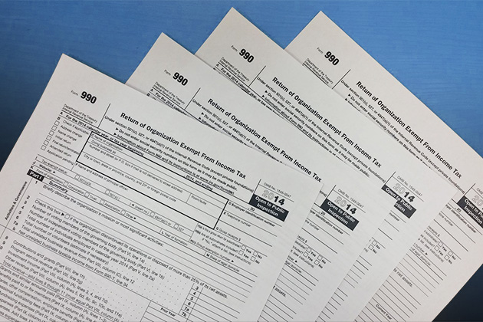
Who can be rated?
Must be a 501(c)(3) organization
Must be U.S.-based
Must have filed the full Form 990 (Not 990-EZ, 990-PF or 990N)
Must have filed at least 3 years of returns

Slide 7

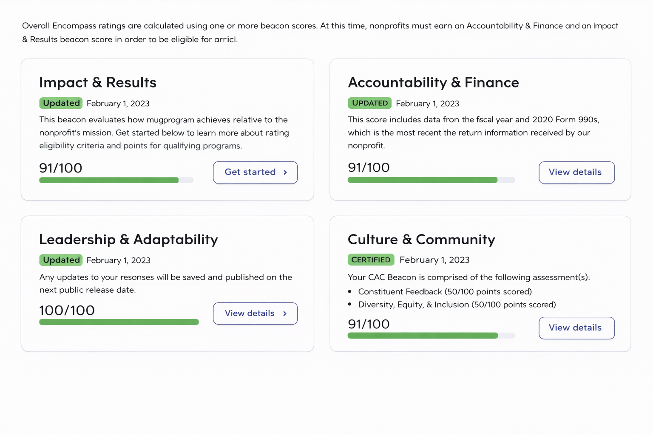


Where do they get their data?
IRS
The IRS makes 990s available to the public after filing
The Nonprofits Themselves
Organizations self-report information via the portal
Data Partners
Partners share data that they have collected about nonprofits.

Slide 8
How frequently are ratings updated?
Ratings are updated every two months (monthly in November & December)
Deadlines are typically the second week of the month before the update
Annual methodology changes are announced in February and effective that Spring

Slide 9
The Rating System

Slide 10
The Encompass Rating System
Encompass Rating System provides a comprehensive analysis of charity performance across four key domains, which they call “beacons”
Accountability and Finance
Leadership and Adaptability
Culture and Community
Impact and Measurement

Slide 11
The Accountability & Finance Beacon
Accountability
Up to 18 metrics depending on the size and source of revenue
Most of the information comes directly from the 990
For some organization with >$50 million in revenue the organization’s website is reviewed
Some metrics only apply to “Donor funded” organizations, meaning that >40% of their support comes from contributions (as opposed to program service revenue

Slide 12
The Accountability & Finance Beacon
Finance (up to 4 metrics)
All organization sizes
  Program Expense Ratio (Total Program Expenses/Total Expenses)
  Liabilities to Assets (Total Liabilities/Total Assets)
>$2 million and 40% donor funded
  Working Capital Ratio – recommended 6 months (Working Capital/Average Monthly Expenses)
  Fundraising Efficiency - excluded if no fundraising (Total Fundraising Expenses/Total Contributions)
Metrics are retired if they don’t work or inadvertently penalize a certain subset of organizations

Slide 13
The number of metrics used varies by size and structure
 | Large | Medium | Small | Extra Small | Other
Revenue Size | $50M+ | $2M-$50M | $500K-$2M | <$500K | n/a
Donor Support $ contributions/total revenue | 40%+ | 40%+ | NA | NA | Not donor supported
Years of 990 Filing | 3 | 3 | 3 | 3 | 3
Metrics Evaluated | All metrics (Finance, Accountability, and Website) | All automated Accountability metrics and all Finance metrics | Focused set of Finance and Accountability metrics | Focused set of Finance and Accountability metrics | Focused set of Finance and Accountability metrics

Slide 14
Accountability Metric Ratings
Metric | Calculation | Rating
Board Composition | At least 3* Board Members * - 5 for large donor funded | Yes – Full points No – 0 points
Independence | At least 50% of board is independent | Yes – Full points No – 0 points
Audited Financial Statements | Revenue >$2 million – is audit present and have an oversight committee Revenue >$1 million – is audit present Revenue $500K- $1 million – is audit, review or compilation present | Yes – Full points No – 0 points
Material Diversion of Assets | Yes or No | No – Full points Yes – 0 points

Slide 15
Accountability Metric Ratings: Disclosures
Metric | Rating | Metric
Website listed | Yes – Full points No – 0 points | 990 provided to board before filing* | Yes – Full points No – 0 points
Conflict of Interest Policy present | Yes – Full points No – 0 points | Donor Privacy Policy** | Yes – Full points No – 0 points
Whistleblower Policy present | Yes – Full points No – 0 points | Board members listed on website** | Yes – Full points No – 0 points
Document Retention & Destruction Policy present | Yes – Full points No – 0 points | Key staff members listed on website** | Yes – Full points No – 0 points
Board meeting minutes | Yes – Full points No – 0 points | Audited financials listed On website** | Yes – Full points No – 0 points
990 disclosed on website | Yes – Full points No – 0 points | Process for determining CEO compensation** | Yes – Full points No – 0 points
Loans to/from related parties* | No – Full points Yes – 0 points | CEO listed on 990 with salary** | Yes – Full points No – 0 points
* Applies only to donor funded organizations with >$2 million in revenue
**Applies only to donor funded organization with >$50 million in revenue

Slide 16
Finance Metric Ratings
Metric | Calculation | Rating
Average Program Expense Ratio | Average Program expense/Average total expense | >70%: 25 pts 50-70%: 1-24 pts linear <50%: 0 pts
Liabilities to Assets Ratio | Total Liabilities/Total Assets | 30% or less: 25pts 70%-30%: 1-24 pts >70%: 0 pts
Fundraising Efficiency (>$2M in revenue only) | Average Fundraising Expense/Total Contributions | $0.20 or less: 25pts $0.50-$0.20: 1-24 pts >$0.50: 0pts
Working Capital (>$2M in revenue only) | Working Capital/Average Total Expenses | 6 months or greater: 25pts 1-6 months: 1-24 pts Less than 1 months: 0 pts

Slide 17
Leadership and Adaptability Beacon
Purpose: Assess a charity’s leadership capacity, strategic development, and ability to adapt to internal and external changes to better deliver on its mission
Charity Navigator asks nonprofits to provide information on:
Mission, Vision, and Goals
Leadership Investments
Adaptability and Learning

Slide 18
Leadership and Adaptability Beacon
Self reported using the Nonprofit Portal (10-15 minutes)
Survey includes questions on:
  Strategic goals – Describe your goals and identify the category that best describes each one.
  Leadership development – Which leadership development initiatives have you invested in?
  External mobilization - How do you engage externally to advance your mission?
  Adaptability – What strategies did your nonprofit take to ensure sustainability and/or adapt to change?

Slide 19
Culture & Community Beacon
Score based on the completed of the How We Listen and Equity Strategies Survey in Nonprofit Portal
Organizations receive full credit for completing the How We Listen survey
Score for Equity Strategies depends on the number of practices checked (more is better)
Purpose: To evaluate the nonprofit’s overall culture and commitment to fostering meaningful relationships within its organization and the communities it serves

Slide 20
Culture & Community Beacon
  Equity Strategies Checklist
  Asks 14 questions on adoption of best practices in equity
  Data-related question about capturing and analyzing data staff and beneficiaries' demographic data
  Policies-related questions about board and staff diversity, inclusive leadership, and ongoing equity
  How We Listen Survey
  Questions include:
    Does your organization collect feedback?
    How is your organization using feedback from the people you serve?
    Which of the following feedback practices does your organization routinely carry out?
    What challenges does your organization face in collecting feedback from the people you serve

Slide 21
Impact & Measurement Beacon
Purpose: Evaluate nonprofit impact through two assessments: Impact and Measurement
Measuring Outcomes (New)
Impact
Evaluates how a nonprofit collects and uses data to improve its program
Open to all nonprofits
Answers two questions:
  Is this nonprofit achieving its mission?
  Is this nonprofit achieving its mission in a way that it is cost-effective?
New Impact Report Builder in pilot
Inputs
Outputs
Attributed Outcomes
Stories
Measured Outcomes
Cost-Effectiveness

Slide 22
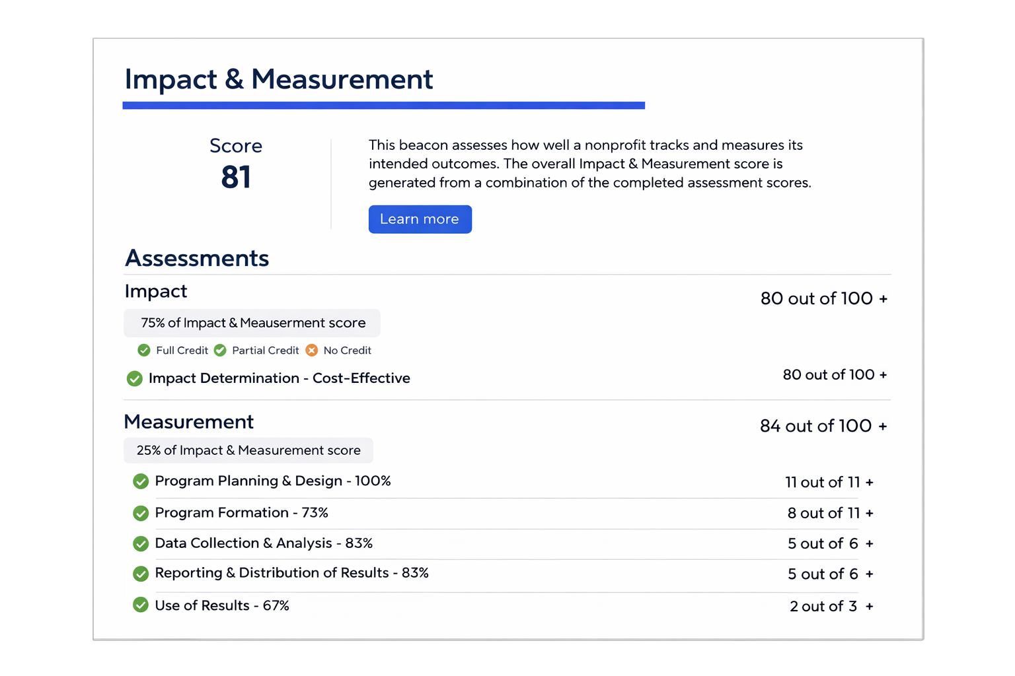
Impact & Measurement Beacon
You can have an Impact score (75%), a Measurement score (25%), or BOTH (best)
Your profile page will show the donor how you scored on Impact and each of the Measurement sections
Charity Navigator provides a Measuring Outcomes User Guide in the Nonprofit Portal to help with the assessment and provide important resources

Slide 23
Measurement
The assessment’s metrics are in five distinct sections:
Program Planning & Design – assesses the use of crucial evaluation tools for program objective setting activities
Program Development – assesses the consideration of stakeholders in program objectives and activities
Data Collection & Analysis – assesses best practices used in collecting and analyzing data
Reporting & Distribution of results – assesses reporting and dissemination program results
Use of results – assesses the use of results to guide learning

Slide 24
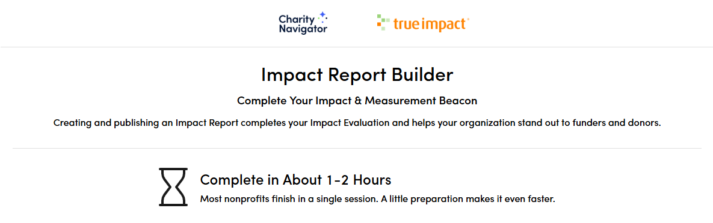
Impact
The Impact Assessment is currently in a pilot program
Once the impact report is completed, you can export it and use it for your own marketing
You can complete/update your report once every 6 months

Slide 25
Impact
Impact Reports are currently only supported for the following nonprofit types
Arts & Culture
Community and Economic Development
Disaster Management
Diversity, Equity, Inclusion and Accessibility
Education
Environment and Sustainability
Food Security
Housing & Human Services
Youth
Public Safety

Slide 26
Beacon Impact on Total Score
The weight of each Beacon depends on how many assessments the nonprofit has completed. If a charity has completed all assessments the weighting is as follows:

Slide 27
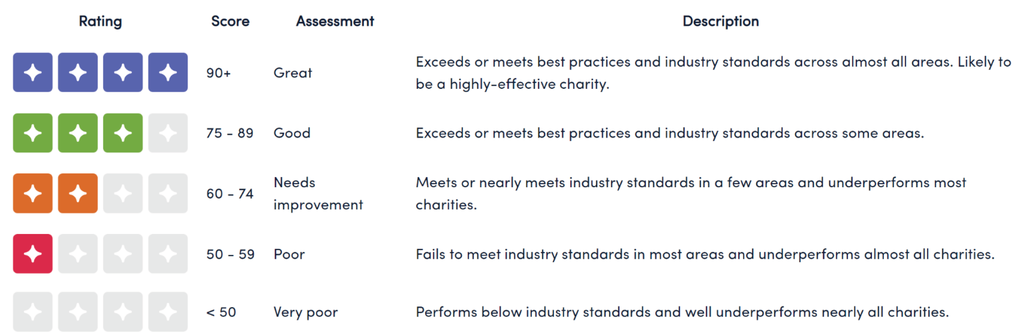
Beacon Impact on Total Score

Slide 28
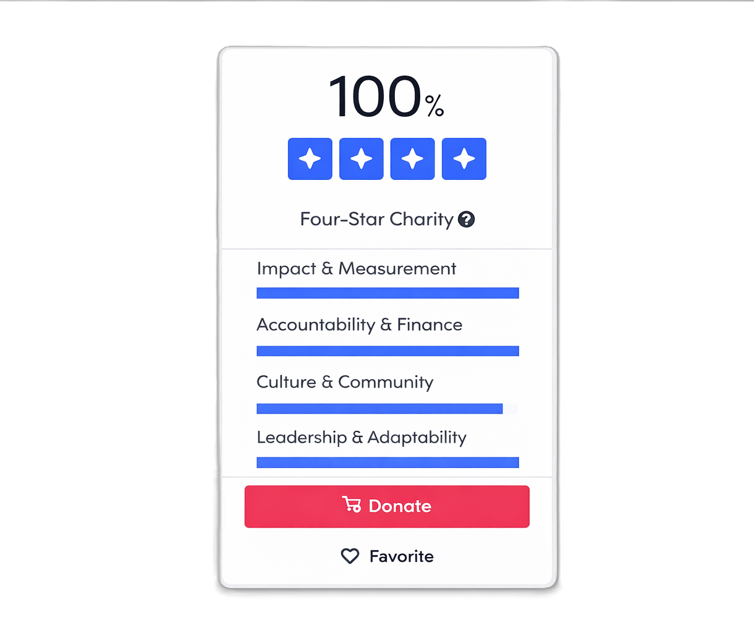
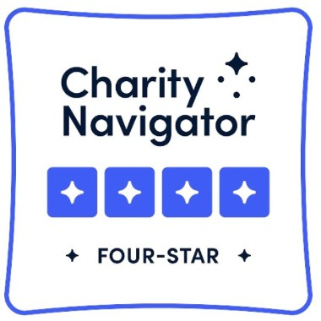
How Beacon Completion Increases Visibility
Nonprofits with more beacons are prioritized in Charity Navigator’s search algorithm, appearing higher in search results
Advanced search allows donors to search organizations by beacon completion
On average, nonprofits receive more and higher donations for every beacon that they complete
Beacon completion is required for list-eligibility, including Where to Give Now and Best Charities

Slide 29
How to maximize your organization’s ratings?

Slide 30
How to Maximize Ratings
Ensure that your 990 is accurate and reflects all policies that are in place
Adopt key policies if they are not in already in place
Leverage the knowledge of the finance and adaptability beacon to provide early warning signs to leadership
Review rating for accuracy and submit additional information on the portal
Activate all the beacons and make sure that they are updated regularly for significant changes

Slide 31
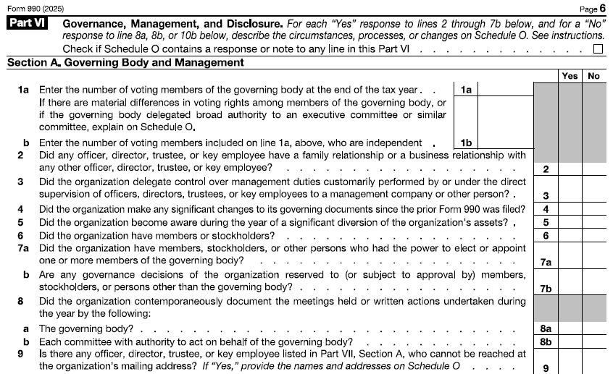
How to Maximize Ratings
Carefully review Part VI, Sections A, B & C of your 990

Slide 32
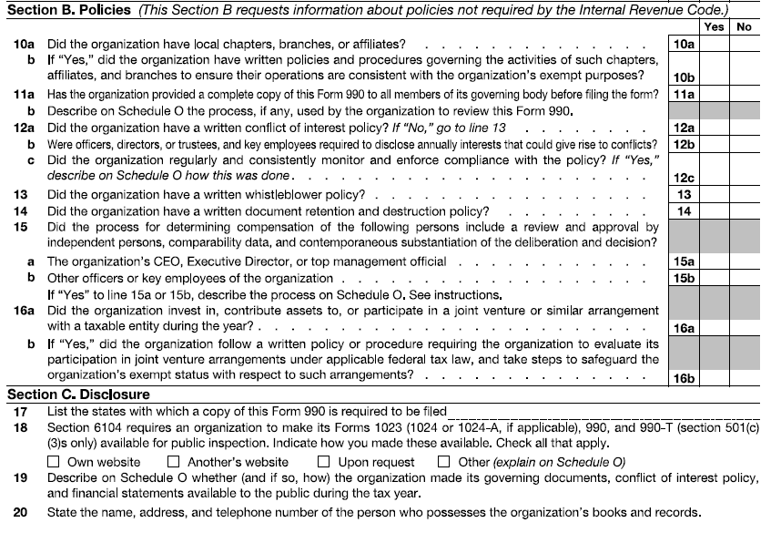
How to Maximize Ratings
Carefully review Part VI, Sections A, B & C of your 990.
If you don’t have all the policies listed in Part B, implementing those is low hanging fruit.

Slide 33
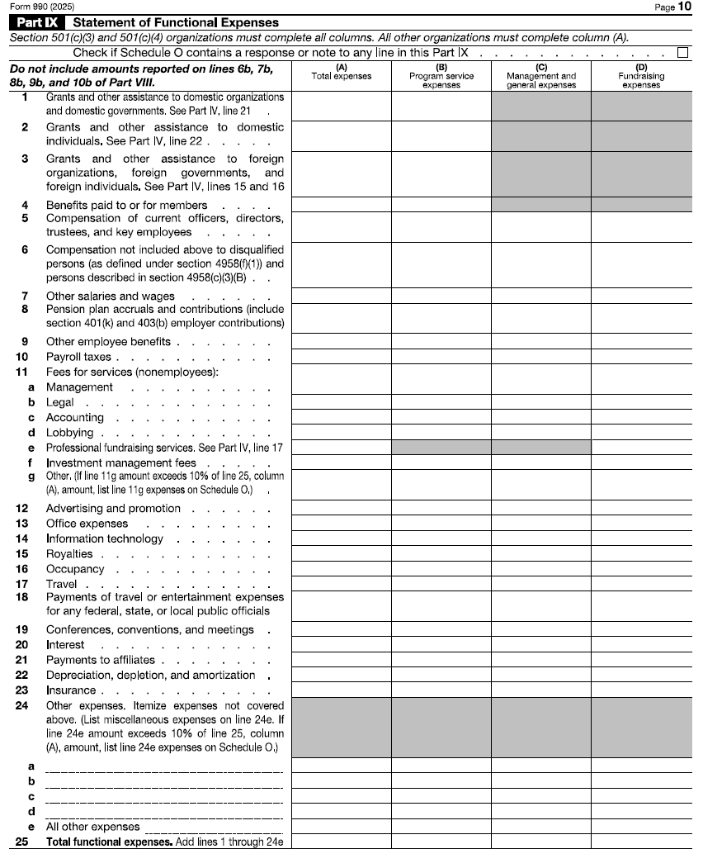
How to Maximize Ratings
Keep an eye on your Functional Expense Allocations throughout the year.
Periodically (at least annually) review your allocation methodologies to ensure that they accurately reflect your programmatic activity.
Review Part IX (page 10 ) of your 990 and calculate your program expense ratio Line 25, Column B divided by Line 25, Column A.

Slide 34
Maximize Ratings by Identifying Opportunities
Metric | Calculation | Rating | Projected Rating
Average Program Expense Ratio | Average Program expense ($6.4M) /Average total expense ($10M) | >70%: 25 pts 50-70%: 1-24 pts linear <50%: 0 pts | 64%(16 points) +300K Program→ 3% to Ratio→ +4 points
Liabilities to Assets Ratio | Total Liabilities ($2M) /Total Assets ($10M) | 30% or less: 25pts 70%-30%: 1-24 pts >70%: 0 pts | 20% (25 Points)
Fundraising Efficiency (>$2M in revenue only) | Average Fundraising Expense ($1M) /Total Contributions ($10M) | $0.20 or less: 25pts $0.50-$0.20: 1-24 pts >$0.50: 0pts | $0.10 (25 Points)
Working Capital (>$2M in revenue only) | Working Capital ($2M) /Average Total Expenses ($10M) | 6 months or greater: 25pts 1-6 months: 1-24 pts Less than 1 months: 0 pts | 2.5 Months (8 points) +$500K to capital→ +1 month→ +4 points
Notes:
74 points (Needs Improvement) to 82 Points (Good)

Slide 35
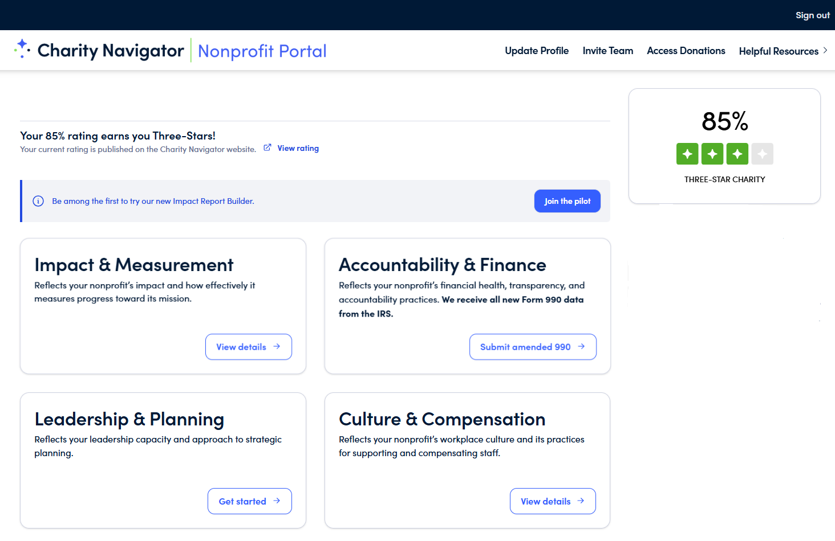
Get to Know the Nonprofit Portal
Your Charity

Slide 36
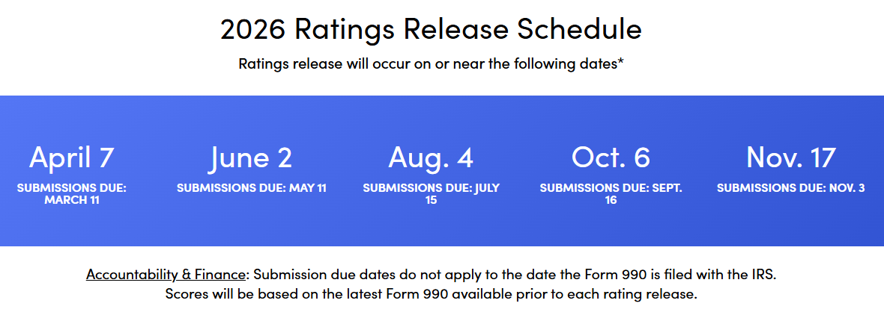
Make Updates as Needed

Slide 37
Additional Resources
  Charity Navigator
  Main Page
  Charity Navigator Rating Methodology Guide
  Nonprofit Portal & Resources
  Evergreen Alliance
  www.EvergreenAllianceCPA.com
  GuideStar (Candid)
  www.guidestar.org

Slide 38

For More Information…
Rebecca Christiansen, CPA
Compliance Partner
714.461.3856
RChristiansen@EvergreenAllianceCPA.com
EvergreenAllianceCPA.com

